Slide 1
Introduction to Docker and Kubernetes
David Yang
Cloud Platform Team, Taiwan

Slide 3
時間 | 議程
9:30am - 10:00am | Registration
10:00am - 10:10am | Welcome from the team / Agenda Introduction
10:10am - 10:45am | Introduction to Docker and Kubernetes
10:45am - 11:00am | Break
11:00am - 11:30am | WebLogic on Kubernetes Recap
11:30am - 12:30pm | HOL
 | Set up OKE on OCI
 | Install WebLogic Operator
12:30pm - 1:30pm | Lunch
1:30pm - 4:45pm | HOL
 | Deploy WebLogic Domain
 | Scaling WebLogic Cluster
 | Override JDBC configuration
 | Rolling update of deployed application
4:45pm - 5:00pm | Wrap Up

Slide 4
Approach for This Presentation
Docker 101
Introduction
Use cases
Architecture
Kubernetes 101
Introduction
Architecture
Concepts
Q&A

Slide 5
Approach for This Presentation
Docker 101
Introduction
Use cases
Architecture
Kubernetes 101
Introduction
Architecture
Concepts
Q&A

Slide 6

Introduction
Evolution of Computing
Development Process
Waterfall ➔ Agile ➔ DevOps
Application Architecture
Monolithic ➔ N-tier ➔ Microservices
Deployment and Packaging
Physical Server ➔ Virtual Server ➔ Container
Application Infrastructure
Datacenter ➔ Host Environment ➔ Cloud

Slide 7


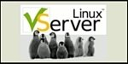

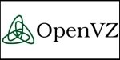

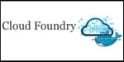
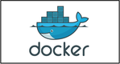
History of Containers
1979
2000
2001
2004
2005
2008
2011
2013
UNIX V7
Free BSD Jails
Linux vServer
Solaris Containers
Open Virtuzzo
LXC
Warden
Docker
While Docker has been playing a key role in adoption of the Linux container technology, they did not invent the concept of containers
However, they have made the technology consumable by mere humans

Slide 8
How is it different to Virtual Machines?
VM 1
VM 2
App
App
VM 1
VM 2
OS
OS
Container Engine
App Packaging
Higher Density
Portability
Disposability
Light Weight
App
App
Container 1
Container 2
App
App
OS
OS
Hypervisor
Hypervisor
Operating System
Operating System
Hardware
Hardware
Hardware
Hardware Virtualization
Para-virtualization
Containers

Slide 9
Use Cases
Application Packaging
Package applications with supporting environment in immutable, portable containers
Infrastructure Consolidation
Infra utilization up to 100% due to over subscription of resources and near bare metal performance
Continuous Integration
Changes to app are contained in one immutable container image that is tested and deployed as one atomic unit
DIY PaaS
Build a simple PaaS by wiring up containers to a load balancer. Code patches are pushed as new image

Slide 10

Architecture
Daemon – listens for API requests and managed docker objects
Client – is the primary way to interact with runtime
Registry – stores docker images

Slide 11
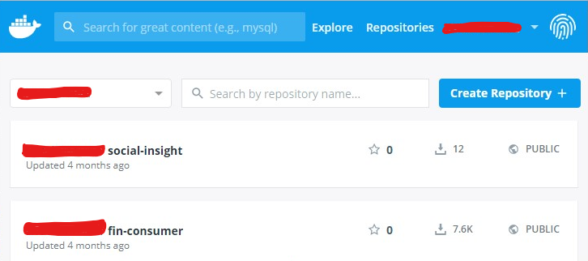
Docker Hub
Public Registry
Enable images to be shared
$ docker tag docker-whale:latest username/docker-whale:latest
$ docker push username/docker-whale:latest
$ docker pull username/docker-whale:latest

Slide 12
Dockerfile
a text file
Instructions to build docker images
FROM nginx:1.10.1-alpine
Add index.html /usr/share/nginx/html/index.html
# Override the nginx start from the base container
COPY start.sh /start.sh
RUN chmod +x /start.sh
ENTRYPOINT ["/start.sh"]

Slide 13
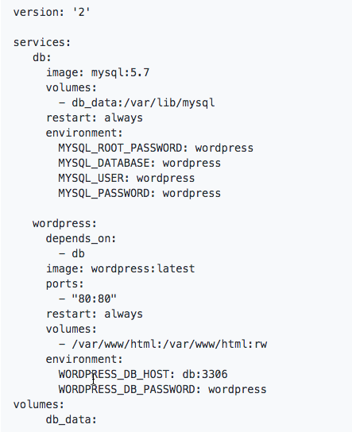
Simple commands to docker build and run
docker build -t helloworld:1.0 . The “.” references Dockerfile in local directory
docker run helloworld
$ docker-compose up -d Docker Tool for defining and running multi-container Docker applications
docker-compose.yml

Slide 14
Approach for This Presentation
Docker 101
Introduction
Use cases
Architecture
Kubernetes 101
Introduction
Architecture
Concepts
Q&A

Slide 15
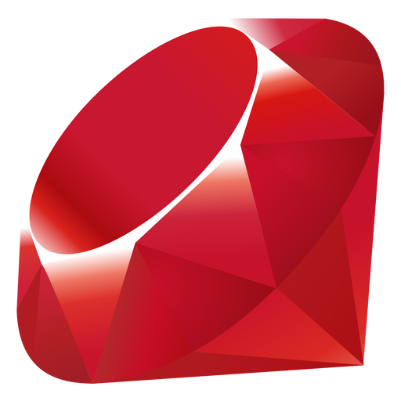

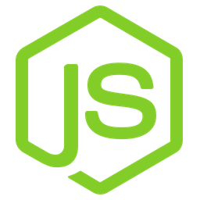
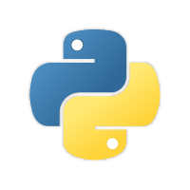
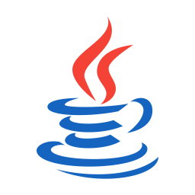
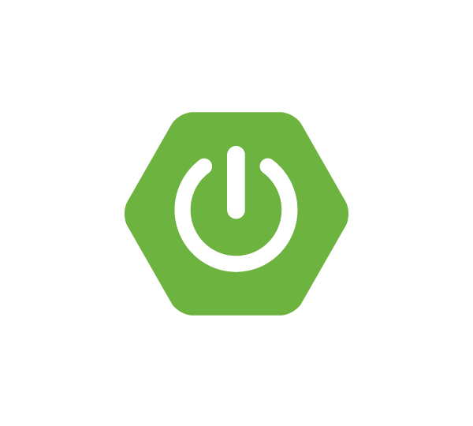

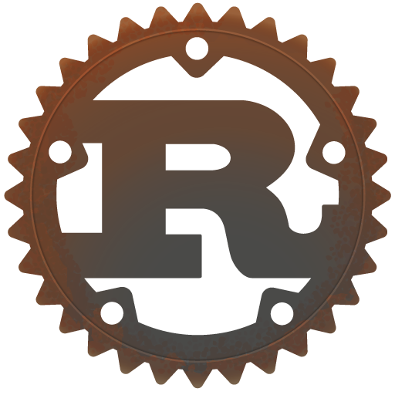
Introduction – Why Orchestrator?
Containers
Containers
A Lifecycle management tool required to,
Service Discovery
Load Balancing
Secrets/Configurations/Storage Management
Health Checks
Auto-scaling/healing of Containers
Zero-downtime Deployments
Operating System
Operating System
Hardware
Hardware
Host/Node-1
Host/Node-2

Slide 16
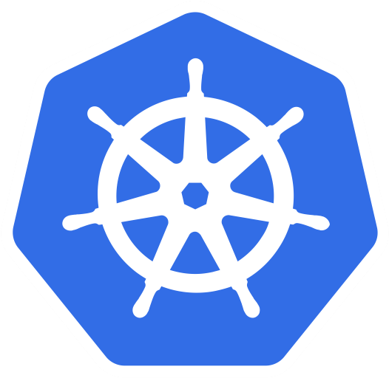
Kubernetes
Production-Grade Container Orchestration
An open-source platform for managing containerized apps in production
Automated container deployment, scaling, and management

Slide 17



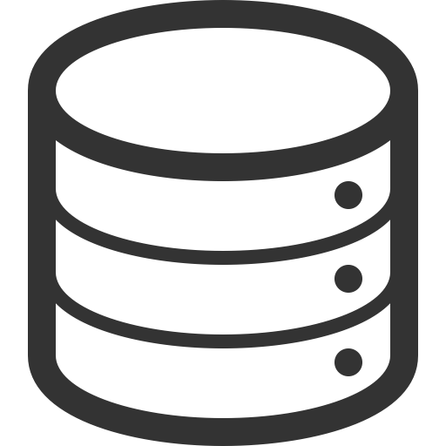
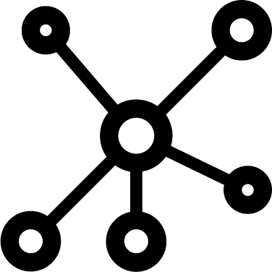
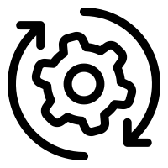
Kubernetes Landscape
- Modular in Design
Identity Provider
Cloud Provider
DevOps
CI/CD
Image Repository
Service Discovery
Compliance
kubectl
Chat Ops
Execution
Self Healing
The Core
The Controller
Management
Interface
Environment
Volume Plugin
API
helm
Minikube
Routing
Authorization
Load Balancing
MicroK8S
Network Plugin
Kops
Container Runtime
Notes:
Kubernetes Core Features
Also referred to as the control plane, it is the most basic part of the whole system. It offers a number of RESTful APIs that enable the cluster to do its most basic operations. The other part of the core is execution. Execution involves a number of controllers like replication controller, replicaset, deployments...etc. It also includes the kubelet, which is the module responsible for communicating with the container runtime.
The core is also responsible for contacting other layers (through kubelet) to fully manage containers. Let’s have a brief look at each of them:
Container runtime
Kubernetes uses Container Runtime Interface (CRI) to transparently manage your containers without necessarily having to know (or deal with) the runtime used. When we discussed containers, we mentioned that Docker, despite its popularity, is not the only container management system available. Kubernetes uses containerd (pronounced container d) by default as a container runtime. This is how you are able to issue standard Docker commands against Kubernetes containers. It also uses rkt as an alternative runtime. Don’t be too confused at this part. This is the very inner workings of Kubernetes that, although you need to understand, you won’t have to deal with almost entirely. Kubernetes abstracts this layer through its rich set of APIs.
The Network Plugin
As we discussed earlier, a container orchestration system is responsible (among other things) for managing the network through which containers and services communicate. Kubernetes uses a library called Container Network Interface (CNI) as an interface between the cluster and various network providers. There are a number of network providers that can be used in Kubernetes. This number is constantly changing. To name a few:
Weave net
Contiv
Flannel
Calico
The list is too long to mention here. You might be asking: why does Kubernetes need more than one networking provider to choose from? Kubernetes was designed mainly to be deployed in diverse environments. A Kubernetes node can be anything from a bare metal physical server, a virtual machine, or a cloud instance. With such diversity, you have a virtually endless number of options for how your containers will communicate with each other. This requires more than one to choose among. That is why Kubernetes designers chose to abstract the network provider layer behind CNI.
The Volume Plugin
A volume broadly refers to the storage that will be availed for the pod. A pod is one or more containers managed by Kubernetes as one unit. Because Kubernetes was designed to be deployed in multiple environments, there is a level of abstraction between the cluster and the underlying storage. Kubernetes also uses the CSI (Container Storage Interface) to interact with various storage plugins that are already available.
Image Registry
Kubernetes must contact an image registry (whether public or private) to be able to pull images and spin out containers.
Cloud Provider
Kubernetes can be deployed on almost any platform you may think of. However, the majority of users resort to cloud providers like AWS, Azure, or GCP to save even more costs. Kubernetes depends on the cloud provider APIs to perform scalability and resources provisioning tasks, such as provisioning load balancers, accessing cloud storage, utilizing the inter-node network and so on.
Identity Provider
If you’re provisioning a Kubernetes cluster in a small company with a small number of users, authentication won’t be a big issue. You can create an account for each user and that’s it. But, if you’re working in a large enterprise, with hundreds or even thousands of developers, operators, testers, security professionals...etc. then having to manually create an account for each person may quickly turn into a nightmare. Kubernetes designers had that in mind when working on the authentication mechanism. You can use your own identity provider system to authenticate your users to the cluster as long as it uses OpenID connect.
Kubernetes Controllers Layer
This is also referred to as the service fabric layer. It is responsible for some higher level functions of the cluster: routing, self-healing, load balancing, service discovery, and basic deployment(for more info, https://kubernetes.io/docs/concepts/services-networking/, and https://kubernetes.io/docs/concepts/workloads/controllers/deployment/ ), among other things.
Management Layer
This is where policy enforcement options are applied. In this layer, functions like metrics collection, and autoscaling are performed. It also controls authorization, and quotas among different resources like the network and storage. You can learn more about resource quotas here.
The Interface Layer
In this layer, we have the client-facing tools that are used to interact with the cluster. kubectl is the most popular client-side program out there. Behind the scenes, it issues RESTful API requests to Kubernetes and displays the response either in JSON or YAML depending on the options provided. kubectl can be easily integrated with other higher level tools to facilitate cluster management.
In the same area, we have helm, which can be thought of as an application package manager running on top of Kubernetes. Using helm-charts, you can build a full application on Kubernetes by just defining its properties in a configuration file.
The DevOps and Infrastructure Environment
Kubernetes is one of the busiest open-source projects out there. It has a large, vibrant community and it’s constantly changing to adapt to new requirements and challenges. Kubernetes provides a tremendous number of features. Although it is only a few years old, it is able to support almost all types of environments. Kubernetes is used in many modern software building/deployment practices including:
DevOps: provisioning ephemeral environments for testing and QA is easier and faster.
CI/CD: building continuous integration/deployment, and even delivery pipelines is more seamless using Kubernetes-managed containers. You can easily integrate tools like Jenkins, TravisCI, Drone CI with the Kubernetes cluster to build/test/deploy your applications and other cloud components.
ChatOps: chat applications like Slack can easily be integrated with the rich API set provided by Kubernetes to monitor and even manage the cluster.
Cloud-managed Kubernetes: Most cloud providers offer products that already has Kubernetes installed. For example AWS EKS, Google GKE, and Azure AKS.
GitOps: Everything in Kubernetes is managed through code (YAML files). Using version control systems like Git, you can easily manage your cluster through pull requests. You don’t even have to use kubectl.

Slide 18
Kubernetes Architecture
Kubernetes Cluster
Master
Worker
Master
Worker
Master
Worker
Notes:
A Kubernetes cluster is a set of physical or virtual machines and other infrastructure resources that are used to run your applications.
Each machine is called a node. There are 2 types of nodes:
Master node: Hosts the K8s control plane and manages the cluster. Think of it like WLS Admin Server. Except you can run multiple masters at the same time.
Worker node: Runs your containerized applications. Think of it like the WLS Managed Server.

Slide 19
Kubernetes Architecture
Kubernetes Cluster
Master
Worker
API Server
kubectl
API Server: Exposes the K8S API and frontend for Kubernetes control.
Notes:
Kubectl is a cmd-line tool that helps you manage K8s resources using REST. You can do all kinds of CRUD operations against K8s resources. Think of it like WLST commands but you use container manifests in YAML/JSON formats.
API Server: Commands from kubectl is translated into REST API call and issued to the API Server. Think of it like the WebLogic’s RESTful management services. Users, other control plane components or other tools e.g. CI/CD tools communicate with it

Slide 20
Kubernetes Architecture
Kubernetes Cluster
Master
Worker
API Server
kubectl
Scheduler
Scheduler: Selects the Nodes for new Pods
Notes:
Scheduler: Works with the API Server to schedule pods to the nodes. It has information about resources available on the nodes and those requested by pods. This is then used to decide which worker node will be selected for deployment.

Slide 21
Kubernetes Architecture
Kubernetes Cluster
Master
Worker
API Server
kubectl
Scheduler
Controller Manager
Ctrl Manager: Process that runs controllers to handle Cluster tasks
Notes:
Controller Manager: a daemon that watches the state of the cluster and reconciles the current state with the desired state e.g. replicating components, keeping track of worker nodes, handling node failures

Slide 22
Kubernetes Architecture
Kubernetes Cluster
Master
Worker
API Server
kubectl
Scheduler
Controller Manager
etcd
etcd
etcd
etcd: Distributed key-value store for Cluster state data
Notes:
Etcd: a simple, reliable, distributed and consistent KV store. It persists the state of all REST API objects, how many pods are deployed to each worker nodes etc. Think of it like the domain config.xml.

Slide 23
Kubernetes Architecture
Kubernetes Cluster
Worker
Master
Kubelet
API Server
kubectl
Scheduler
Controller Manager
etcd
etcd
etcd
kubelet: Responsible for everything on the Worker Node
Notes:
Kubelet: is a service on each node that manages containers and is managed by the master. It talks to the API Server and only manages resources on its node. Think of it like the node manager.

Slide 24
Kubernetes Architecture
Kubernetes Cluster
Worker
Master
Kubelet
API Server
Docker
kubectl
Scheduler
Controller Manager
etcd
etcd
etcd
Docker Runtime: Downloads images and runs containers
Notes:
Docker: is the container runtime running on each node. It understand the Docker image format and how to run Docker containers. Think of it like the JVM.
There’s another container runtime (rkt).

Slide 25
Kubernetes Architecture
Kubernetes Cluster
Worker
Master
Kubelet
API Server
Docker
kubectl
Scheduler
Controller Manager
etcd
etcd
etcd
Pod: basic deployable unit of K8s
Notes:
Pod: the smallest deployable unit that can be created, scheduled and managed. It’s a logical collection of containers that belong to an application. Think of it like a WLS resource group. Or like a logical host.

Slide 26
Kubernetes Architecture
Kubernetes Cluster
Worker
Master
Kubelet
API Server
Docker
kubectl
Scheduler
Controller Manager
etcd
etcd
etcd
Containers: where the application code lives
Notes:
Container: are your applications, packaged and run in Docker or rkt format. Think of it like the war/ear applications you deploy in WLS.

Slide 27
Kubernetes Architecture
Kubernetes Cluster
Worker
Master
Kubelet
Proxy
API Server
Docker
kubectl
Scheduler
Controller Manager
Worker
Kubelet
Proxy
etcd
Docker
etcd
etcd
Proxy: a traffic cop
Notes:
Proxy: runs on each node, acting as a network proxy & load balancer for a service on a worker node. Client requests coming through an external load balancer will be redirected to the containers running in a pod through this proxy.

Slide 28
Kubernetes Architecture
Kubernetes Cluster
Worker
Master
Kubelet
Proxy
API Server
Docker
kubectl
Load Balancer
Scheduler
Controller Manager
Worker
Kubelet
Proxy
etcd
Docker
etcd
etcd
Load Balancer: directs external traffic to and from proxy
Notes:
Load Balancer: an external load balancer that directs traffic to and from the proxy

Slide 29
Namespace
Namespaces provide a way to divide cluster resources b/w multiple users/teams/projects via Resource Quotas
Think of namespaces as virtual clusters backed by the same physical cluster
3 default namespaces
default: any pod, service, replication controller are created in the default namespace
kube-public: for bootstrapping discovery
kube-system: reserved for resources created by the cluster
Kubernetes Cluster
Namespace-A
Namespace-B
Namespace-C

Slide 30

Labels
Key-Value pairs that are attached to objects
Contains attributes of objects that are meaningful to identify
Can be used to organize and select subset of objects
Examples:
"release" = "stable", "release" = "canary"
"environment" = "dev", "environment" = "prod"
"tier" = "frontend", "tier" = "backend", "tier" = "middleware"

Slide 31
Pod
A pod is a collection of containers, with shared storage and network, and a specification on how to run them.
Each pod is allocated its own IP address.
Containers within a pod share this IP address, port space and can find each other via localhost.
Pod
Container
Container
Container

Slide 32
Replicaset
A Replicaset runs “n” number of pods, based on the provided template.
Replicasets can scale up or down the number of pods which are desired.
Pod
Pod
Pod
Container
Container
Container
Container
Container
Container
Container
Container
Container
Replicaset

Slide 33
Service
As pods are, a problem presents itself; it becomes almost impossible to reference an individual pod without complex logic to track topology changes.
Services fix this problem by providing an abstraction over Pods and provide an addressable method of communicating with pods.
Types of Services – ClusterIP, NodePort, LoadBalancer, ExternalName, Headless
Service
Pod
Pod
Pod
Container
Container
Container
Container
Container
Container
Container
Container
Container
Replicaset

Slide 34
Deployment
Describe a desired state
Deployments manage Replicasets and can be used to run rolling upgrades between versions of your applications.
For example, to deploy a new version of an application, the deployment controller will create a new Replicaset and manage the rolling upgrade from the old to the new.
Pod
Pod
Pod
Container
Container
Container
Container
Container
Container
Container
Container
Container
Replicaset
Deployment

Slide 35
ConfigMap
Well designed applications should try to follow the 12-factor app manifesto, for configuration of your applications, this should store configuration in the “environment”.
ConfigMaps solve the problem by allowing to mount configuration files into a Pod as an Environment variable or as a file system mount.
Pod
ConfigMap
Environment
Container
Container
ConfigMap
Volume
Volume Mount
Container
Files

Slide 36
Secret
Secret is very similar to ConfigMap, that is, by its name, “secret”
Pod
Secret
Environment
Container
Container
Secret
Volume
Volume Mount
Container
Files

Slide 37
Ingress
Internet
An Ingress is a collection of rules that allow inbound connections to reach the cluster services.
It can be used for load balancing, to terminate TLS, provides external routable URLs and much more.
In most cases, it is required to have an Ingress Controller Such as Nginx or Traefik
Ingres
Service
Service
Service

Slide 38
Helm
Package manager for K8s
Think of it like yum
Has 2 main components:
Helm Client
Tiller Server
A Helm package is called a chart
Repo
K8S Cluster
Chart-1
Tiller
Chart-2
Helm
(Local Env)
Chart-1
Release
Chart-3
$ helm install Repo/Chart-1

Slide 39
Summary – The levels of abstraction
Deployment
ReplicaSet
Pods
Node Cluster
Worker Node
Node Processes
Kubelet
Kube-Proxy
Container Runtime
Docker Container
Docker Container

Slide 41
Thank You
Questions?

